Slide 1
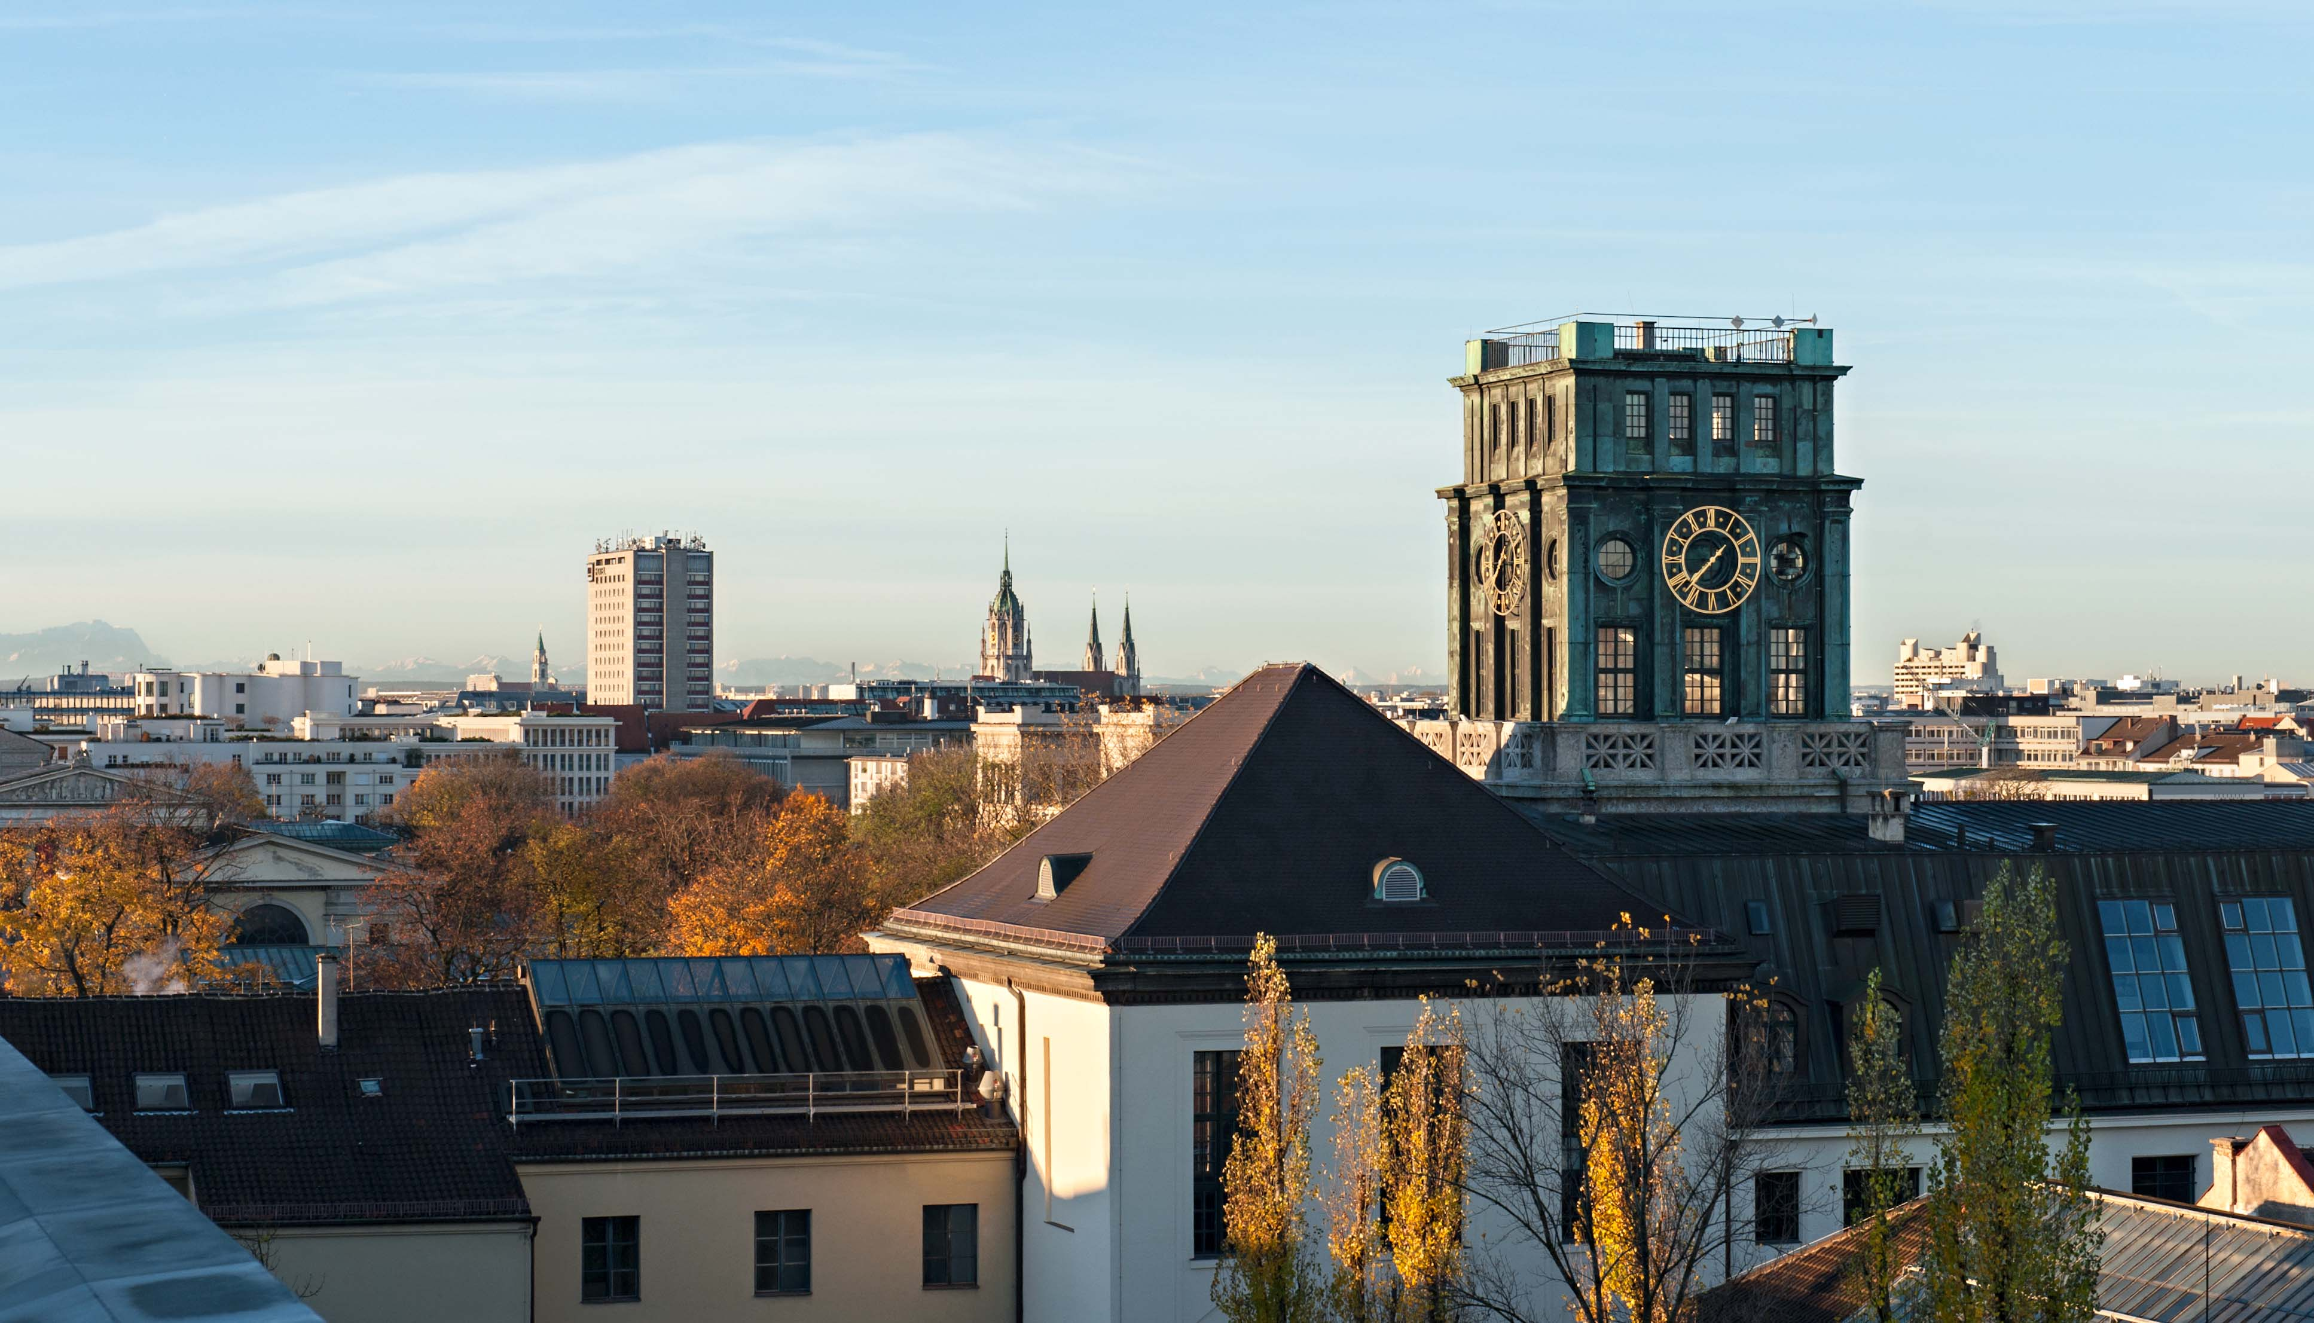

Pecha Kucha ³
The presentation from the group6

Slide 2
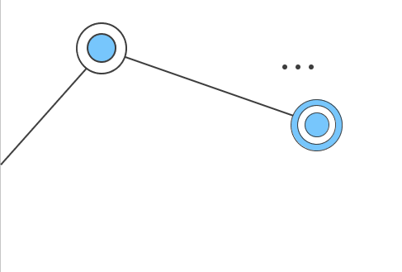

Contents
01
Preparation
02
Algorithm
03
Web Design
04
Git & Docker
05
Timeline
2

Slide 3
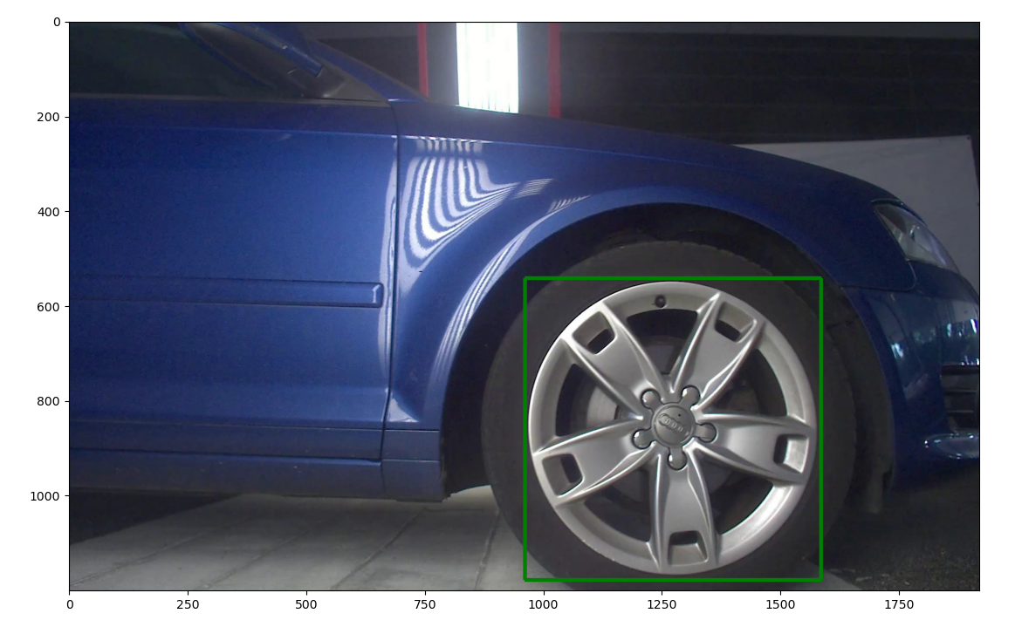

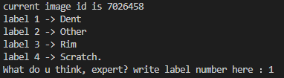

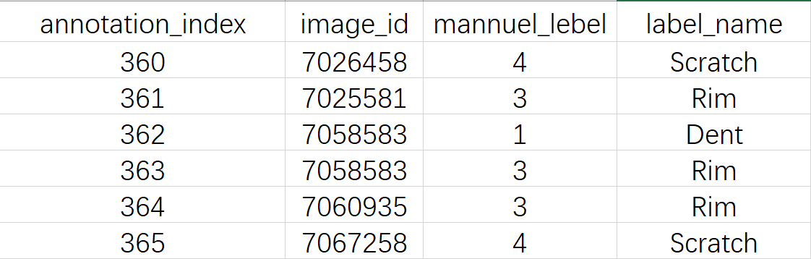

Initial Dataset
Preparation
Data images
Initial Dataset
Labeled dataset
Algorithm
01
Task division
900 images with bounding boxes
Web Design
Data images
Initial Dataset
Labeled dataset
02
Labeling
Manual labelling of damage types
Git & Docker
Timeline
Images classification
3

Slide 4

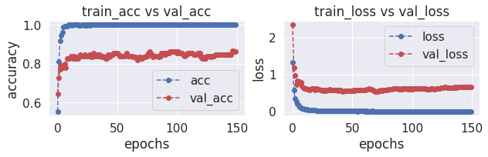
Feature Extraction with InceptionV3
train_acc vs val_acc
Preparation
01
Algorithm
InceptionV3 Accuracy
Web Design
epochs
02
Git & Docker
Timeline
InceptionV3 Loss
train_loss vs val_loss
* Training set size : Test set size = 8:2
4

Slide 5
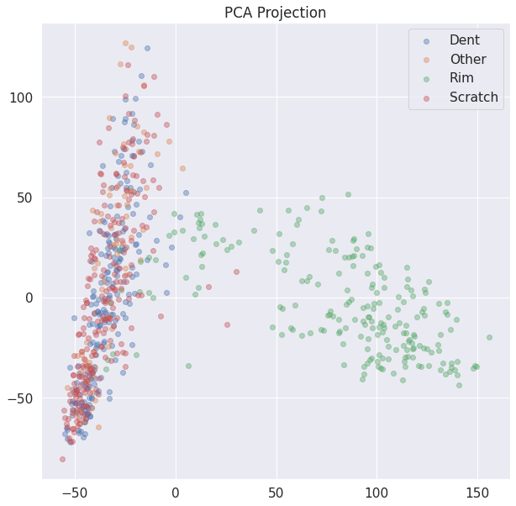
Error Analysis
Preparation
Algorithm
Rim is easy to predict
Dent, Scratch and Other are mixed with each other
Web Design
Git & Docker
Timeline
5

Slide 6
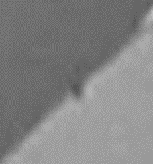
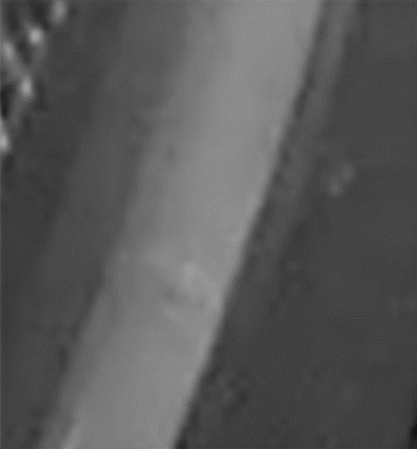
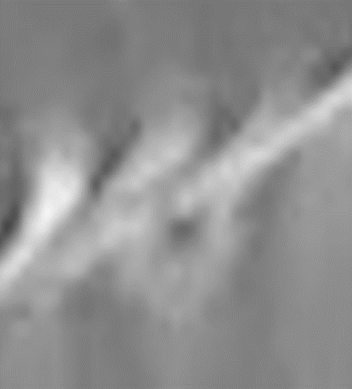
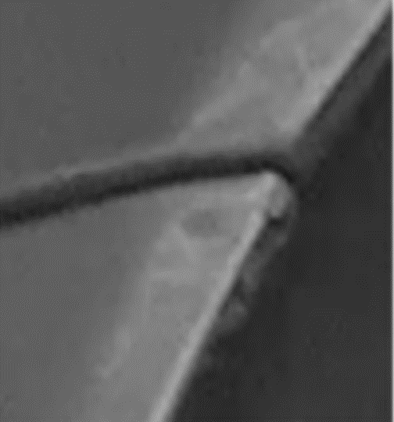

Error Analysis
Preparation
Some examples of mislabeled images by the classifier
Algorithm
Web Design
Git & Docker
Timeline
Predicted: Other
True: Dent
Predicted: Scratch
True: Dent
Predicted: Other
True: Dent
Predicted: Scratch
True: Dent
Predicted: Scratch
True: Dent
6

Slide 7
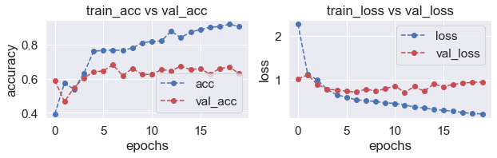
Model Training on a simple CNN
Preparation
Algorithm
Web Design
Git & Docker
CNN Accuracy
CNN Loss
Timeline
* Training set size : Test set size = 8:2
7

Slide 8
Model Training on CNN & KNN
Preparation
Algorithm
Web Design
Git & Docker
CNN Accuracy
CNN Loss
Timeline
Model training on KNN has a worth performance than CNN with an average accuracy of 40%
* Training set size : Test set size = 8:2
8

Slide 9
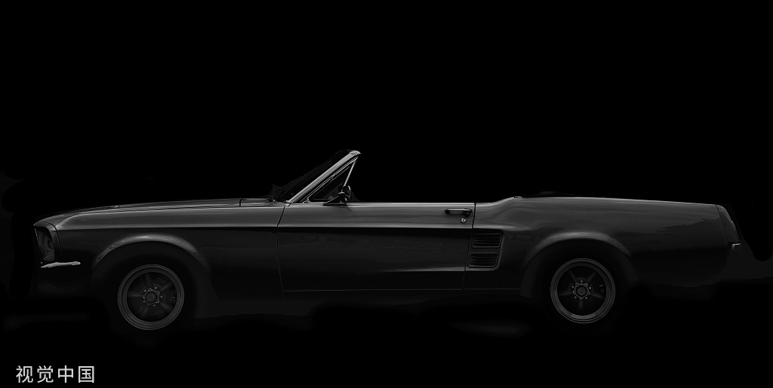
Model Training
Preparation
Algorithm
Try tuning hyperparameters with Inception V3 and other models
Model evaluation using precision and recall, ROC and AUC
Add more data & improve label quality
Web Design
Git & Docker
Timeline
9

Slide 10
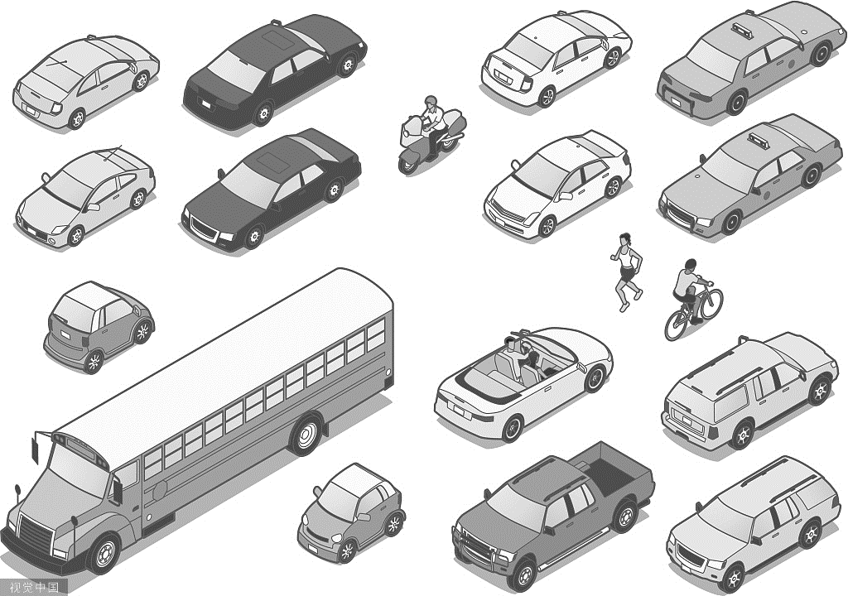






Active Learning
Preparation
Algorithm
Initial training with n random images
Retrain the model
Web Design
Manually label these m images and insert them into the previous training set
Predict all other images
Git & Docker
Timeline
Use different strategies to find the m most critical images in the prediction
10

Slide 11
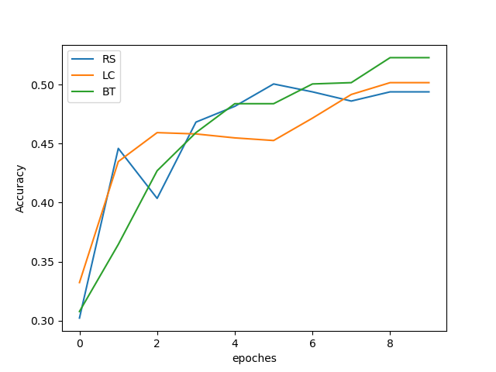
Active Learning
Preparation
Algorithm
3 Strategies:
RS: Random Sampling
LC: Least Confidence
BT: Breaking Ties
Web Design
Git & Docker
Timeline
Active learning accuracy with three strategies
11

Slide 12
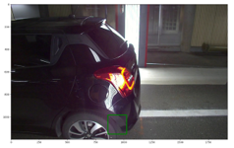
Active Learning
Preparation
n images with the least confidence
Predicted labels & manual correction
Update the dataset
retrain the model
Algorithm
Web Design
1
2
3
Git & Docker
Prediction: rim
Correction: others
Dataset with corrected data
retrain the model
Timeline
12
Notes:
`

Slide 13
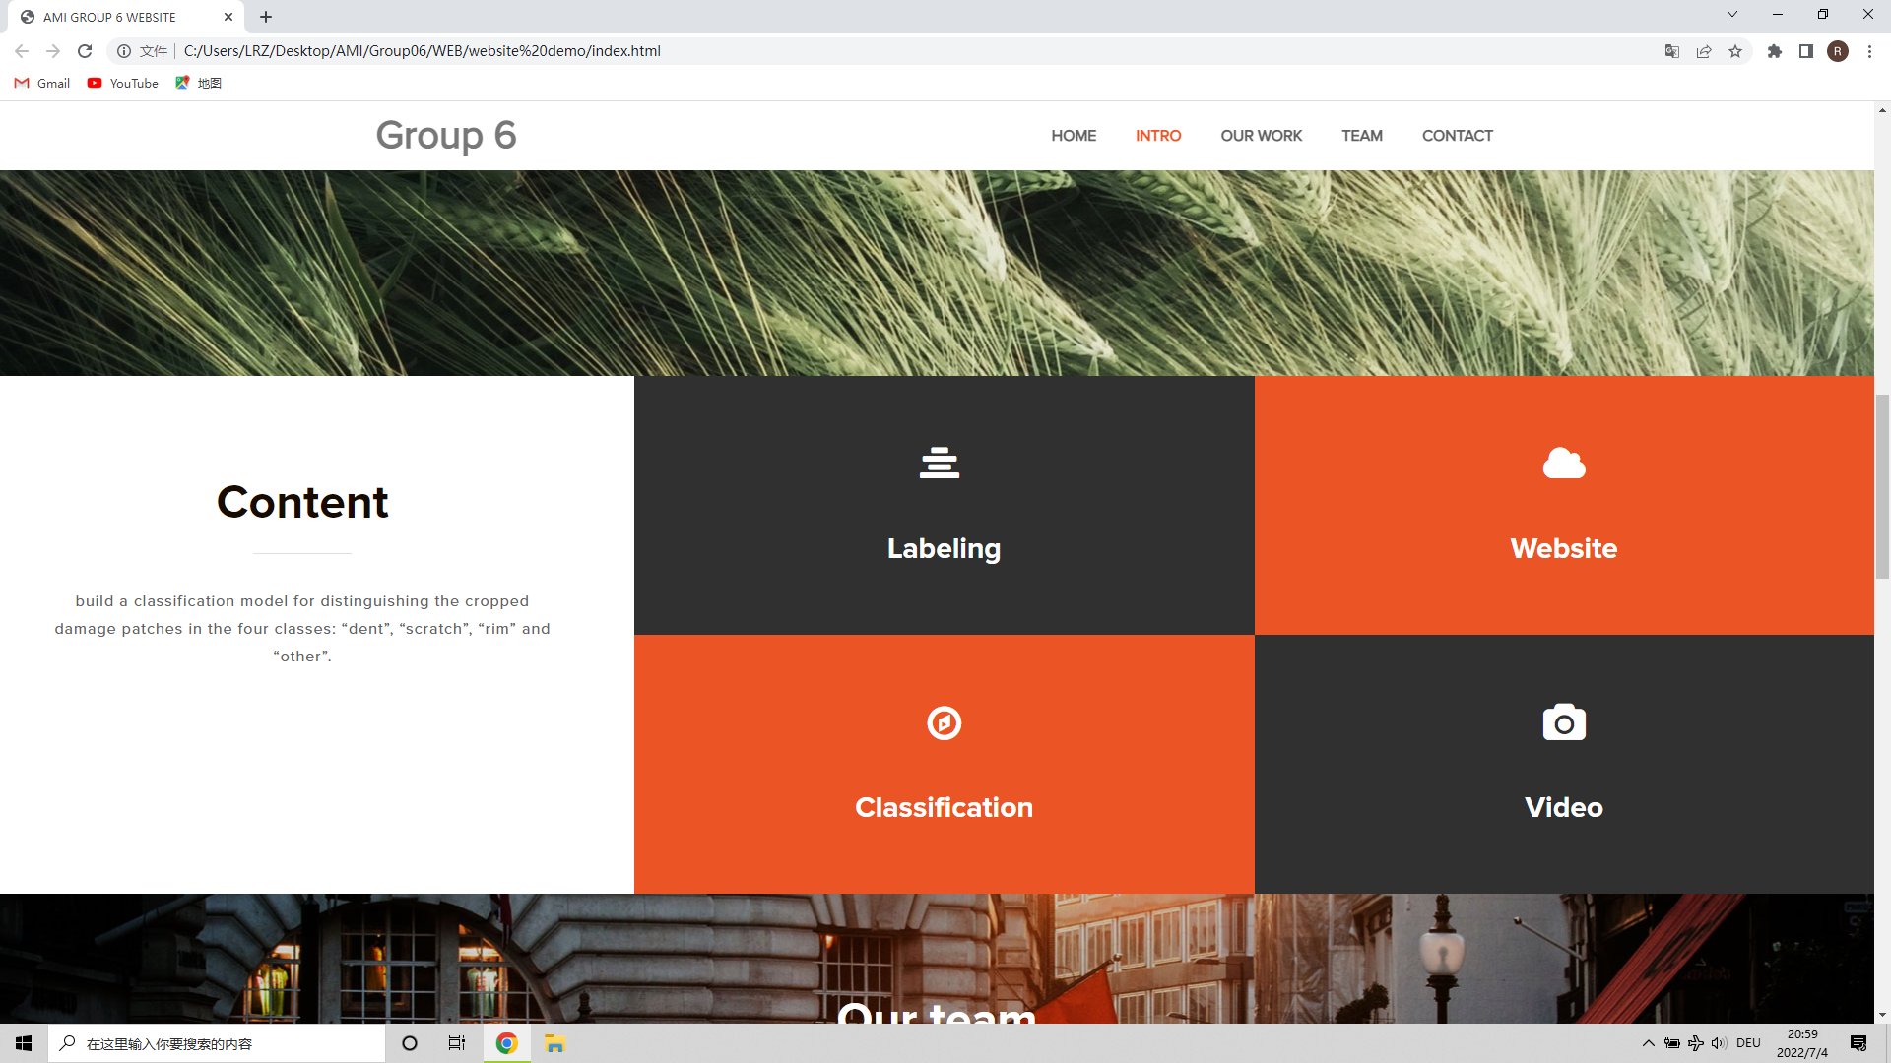
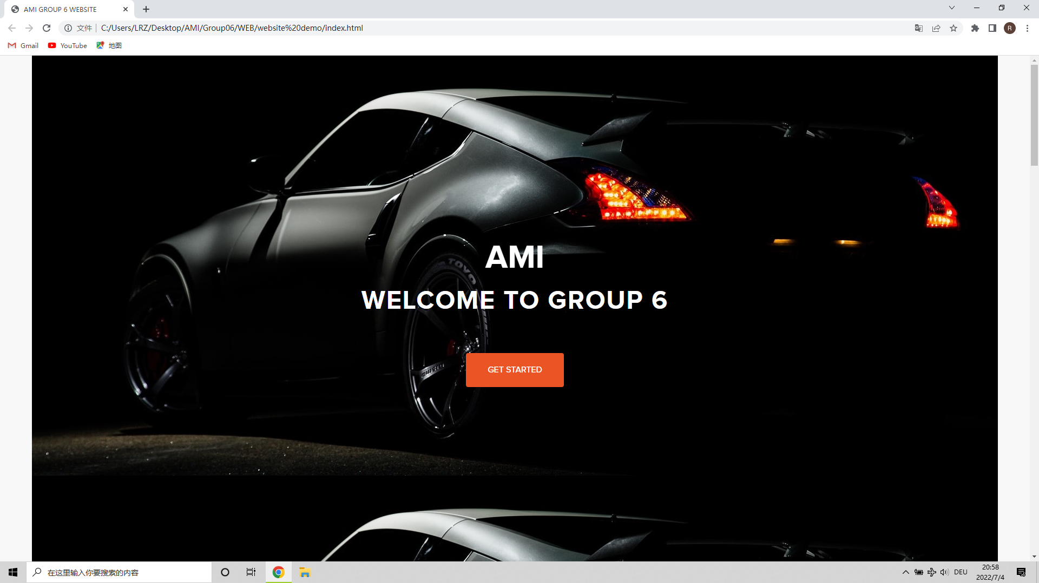




Web Design
Preparation
Algorithm
Web Design
Git & Docker
Timeline
13

Slide 14
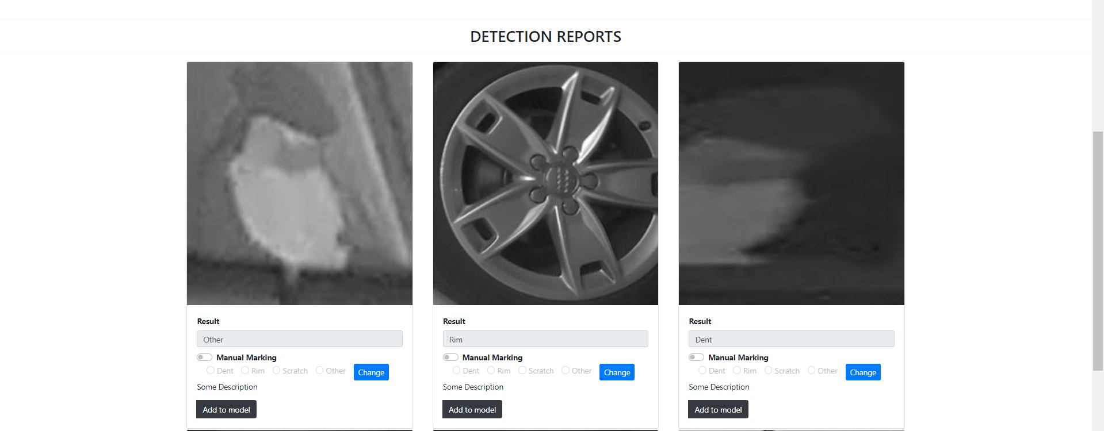
Web Design
Preparation
Algorithm
Web Design
Git & Docker
Timeline
14

Slide 15
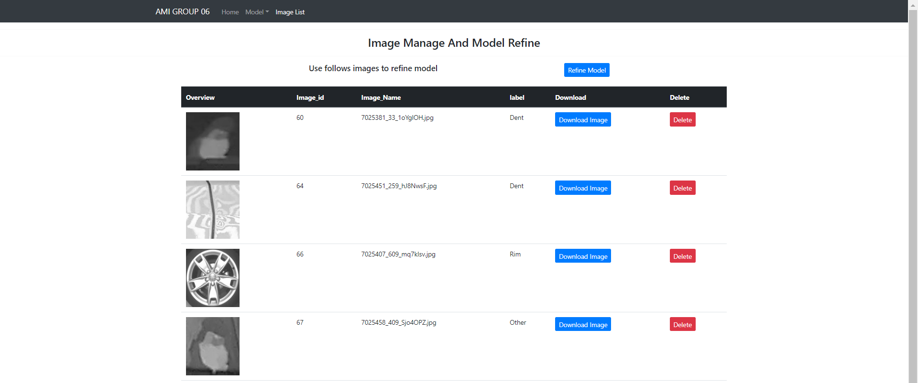
Web Design
Preparation
Algorithm
Web Design
Git & Docker
Timeline
15

Slide 16


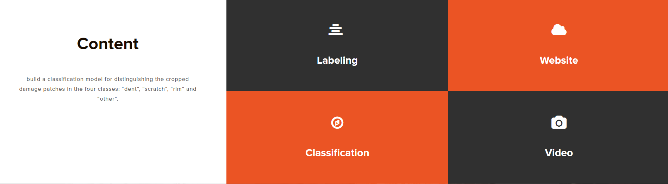
Web Design
Preparation
Algorithm
Integration of the algorithm in the Web
Web Design
Git & Docker
Completion of functions and portals on the web
Development of more visualization
Timeline
16

Slide 17
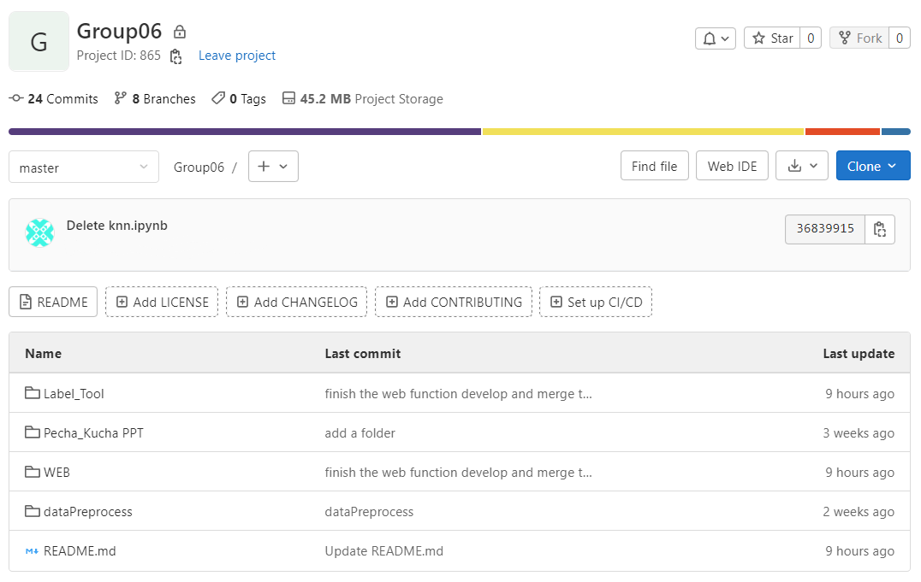
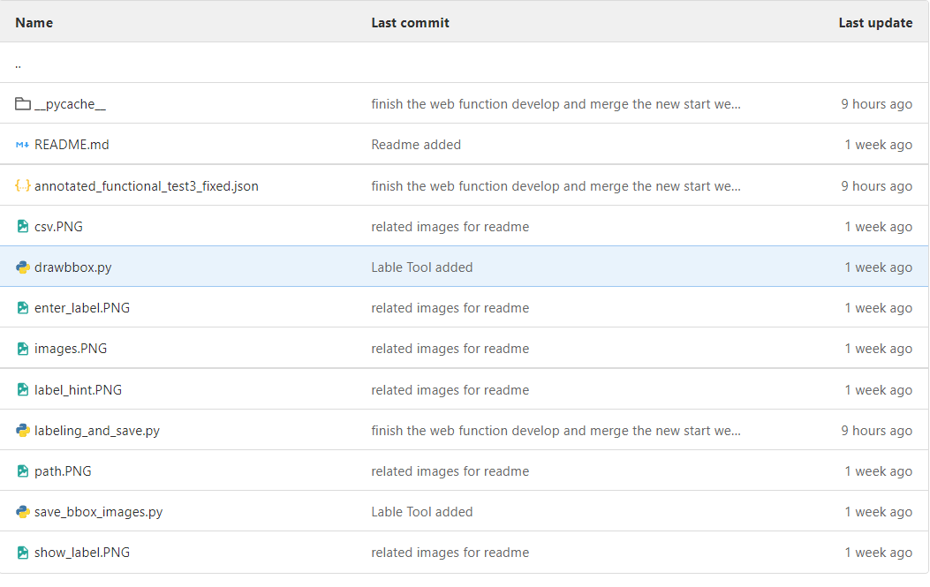


Git & Docker
Preparation
Algorithm
Web Design
Git & Docker
Timeline
17

Slide 18

Git & Docker
Preparation
Labeling
Classification
Algorithm
Prediction
Report
Web Design
Correction
Video
DOCKER ENGINE
Git & Docker
OPERATING SYSTEM
Timeline
18

Slide 19
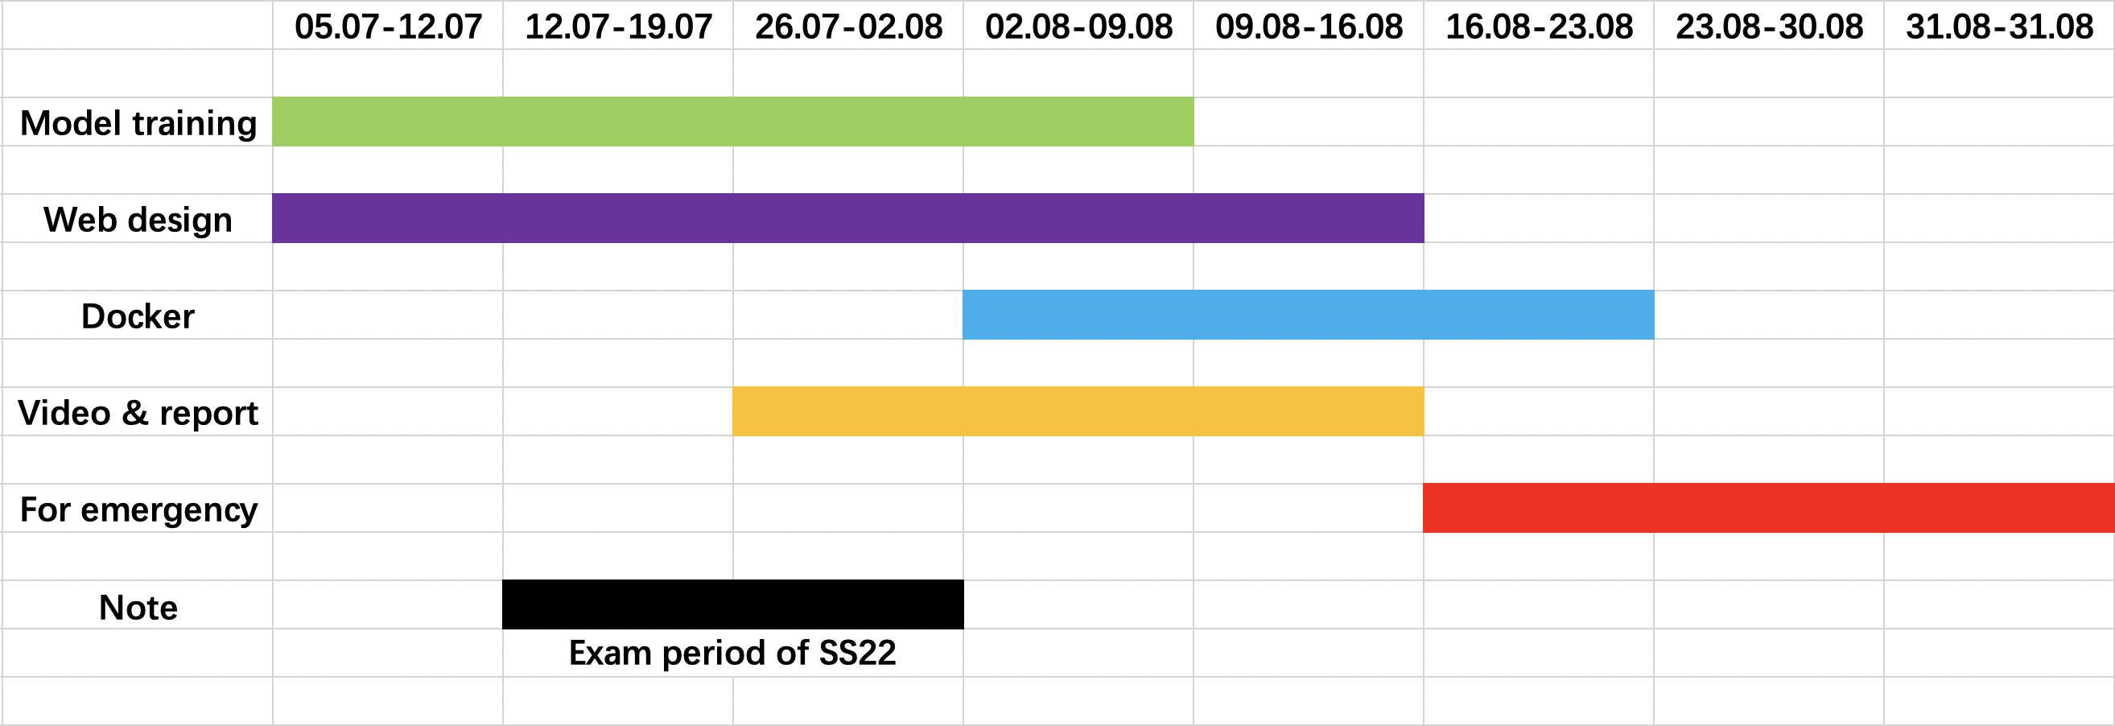
Timeline
Preparation
Algorithm
Web Design
Git & Docker
Timeline
19

Slide 20
Thank you
FOR YOUR ATTENTION
Source: https://stock.adobecom/

